Slide 1

Ansible 101

Slide 2
What is Ansible
Configuration management and orchestration
Similar tools: Chef & Puppet
Automate complex tasks easily
Written in Python
Based in YAML files

Slide 3
Why Ansible
Agentless (Only SSH or PowerShell required)
Supported by RedHat
Simple and powerful
Great community

Slide 4
Use cases
Application deployment
Server provisioning (infrastructure management)
Configuration Management (DevOps)

Slide 5
Basic concepts
Inventory
Tasks
Playbooks
Roles

Slide 6
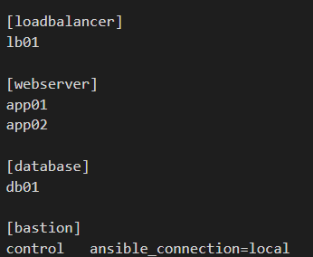
Inventory
Contains hosts to work on
Groups are allowed
SSH as default connection
Host filtering

Slide 7
Task
Basic building block
Made of module and params
Command line or playbooks
Lots of modules available
> ansible –m ping all
> ansible –m command –a “hostname” all

Slide 8
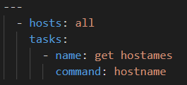
Playbook
YAML File composed of plays
Play is made of target hosts + tasks
Phases on execution
Gather facts (optional)
Task execution
Play recap

Slide 9
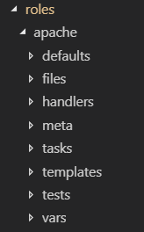
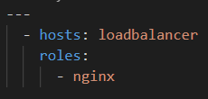
Roles
Encapsulate functionality in a set of files and folders
Help to organize complex projects
Enable code reuse
Used through the roles option
Ansible Galaxy provides roles shared by the community

Slide 10
Examples

Slide 11
Use case. Java Batch Deployment

Slide 12





Jenkins integration
Pipeline + Ansible Plugin + Playbook
Pipeline responsible of lifecycle and artifact management
Ansible just for batch deployment
1.-Get versioned artifact
Jenkins
Artifactory
2.- Provide artifact to Ansible
3.- Deploy batch
Ansible
Target server

Slide 13
That’s all!
Any questions?
Any suggestions?

